Slide 1


Duguma Yeshitla
2025.07.31

Slide 2






Outline
Executive Summary
Introduction
Methodology
Results
Conclusion

Slide 3
Executive Summary
This project employed a comprehensive data science workflow to analyze SpaceX launch records. Data was collected through web scraping and API access, then cleaned and structured for analysis. Exploratory Data Analysis (EDA) and SQL queries were used to identify key trends in booster performance and payload distribution. Geospatial visualization with Folium provided insights into launch site proximities, while an interactive Plotly Dash dashboard enabled intuitive exploration of mission outcomes.
Multiple classification models were trained to predict landing success, with Support Vector Machines (SVM) achieving the highest accuracy at 86%. The findings highlight improvements in launch success post-2015, with NASA and F9 v1.1 boosters playing a major role in heavy-payload missions.

Slide 4

Introduction
SpaceX has attracted global attention through several historic achievements.
It became the first private company to bring a spacecraft back from low-Earth orbit, achieving this in December 2010.
On its website, SpaceX lists the price of a Falcon 9 rocket launch at 62 million dollars, while other providers charge upwards of 165 million dollars. A major factor in the lower cost is SpaceX’s ability to reuse the first stage.
Thus, if we can predict whether the first stage will land, we can estimate the launch cost.
This insight is valuable for any competing company aiming to challenge SpaceX in rocket launch bids.

Slide 5

Section 1

Slide 6
Methodology
Executive Summary
Data collection methodology:
Data was collected using the Space-X open API and scrapping Wikipedia page regarding Space-X launches.
Perform data wrangling
The target Landing outcome class was generated based on the cleaning & transformation of existing data
Perform exploratory data analysis (EDA) using visualization and SQL
Perform interactive visual analytics using Folium and Plotly Dash
Perform predictive analysis using classification models

Slide 7
Data Collection
The dataset was collected through a two-stage pipeline combining web scraping and API integration.
First, we scraped historical SpaceX launch data from the official SpaceX website using the BeautifulSoup library to retrieve launch details like mission name, date, and outcome.
Then, we enhanced this data by querying the SpaceX REST API and the OpenNotify API to gather additional features, including launch site coordinates, payload mass, and orbit details. This hybrid approach ensured both completeness and real-time accuracy.
Web Scraping
Launch Metadata Extraction
API Calls
Feature Enrichment
Final Dataset Assembly

Slide 8
Data Collection – SpaceX API
We collected historical launch data using the SpaceX REST API by sending HTTP GET requests to endpoints such as:
/v4/launches,
/v4/rockets,
/v4/launchpads, and
/v4/payloads.
This allowed us to programmatically retrieve structured JSON data containing launch outcomes, rocket configurations, payload details, and launchpad locations.
Key steps included parsing API responses, normalizing nested data, and merging datasets using unique IDs (e.g., rocket_id, launchpad_id).
Send GET Request to SpaceX API
Receive JSON Response
Parse & Extract Launch Data
Cross-link Rocket, Launchpad, and Payload Info
Assemble Final Dataset
https://github.com/panderior/IBM-DS-Capstone-proj/blob/main/jupyter-labs-spacex-data-collection-api.ipynb

Slide 9
Data Collection - Scraping
We performed web scraping using Python's BeautifulSoup and requests libraries to extract SpaceX launch information from a Wikipedia page related to it.
The process involved sending HTTP GET requests, parsing the HTML structure, and extracting key data such as mission names, launch dates, and success status.
We then stored the extracted data into structured formats like Pandas DataFrames for further cleaning and integration. This approach was used where REST APIs lacked historical or formatted data.
Send HTTP Request to Wikipedia
Parse HTML with BeautifulSoup
Locate Launch Elements (divs, tables, etc.)
Extract Fields (Mission, Date, Outcome)
Store Data in Structured Format (DataFrame/CSV)
https://github.com/panderior/IBM-DS-Capstone-proj/blob/main/jupyter-labs-webscraping.ipynb

Slide 10
Data Wrangling
Raw Data (API / Scraped)
After collecting raw launch data, we performed comprehensive data wrangling to prepare it for analysis and modeling.
This involved removing null entries, normalizing nested JSON structures, and converting categorical values (e.g., landing outcomes) into binary labels.
We used Pandas for merging datasets by keys like launch_id, rocket_id, and payload_id. Irrelevant features were dropped, and numerical values like payload mass were scaled for model compatibility.
The final dataset was clean, structured, and ML-ready.
Drop Nulls & Duplicates
Flatten JSON Columns
Merge Rocket, Launchpad, Payload Tables
Convert Categories to Binary/One-hot
Scale Numerical Features
Export Clean Dataset
https://github.com/panderior/IBM-DS-Capstone-proj/blob/main/labs-jupyter-spacex-Data%20wrangling.ipynb

Slide 11
EDA with Data Visualization
We used visualizations to uncover patterns, trends, and relationships in the SpaceX launch dataset.
Bar plots were used to compare success rates across launch sites, highlighting which locations were most reliable.
Pie charts helped visualize the proportion of successful vs. failed landings.
Scatter plots explored the correlation between payload mass and landing outcome, helping assess whether heavier payloads affect success.
We also used histograms to examine the distribution of payloads and heatmaps to detect potential multicollinearity among numerical features.
These charts guided feature selection and model design by revealing influential variables and outliers.
https://github.com/panderior/IBM-DS-Capstone-proj/blob/main/edadataviz.ipynb

Slide 12
EDA with SQL
Summary of Performed Queries
Selected key columns such as launch site, payload mass, orbit, and landing outcome from the launch dataset.
Filtered successful Falcon 9 launches using WHERE clauses on booster_version and landing_success.
Aggregated launch outcomes by site using GROUP BY to identify top-performing locations.
Used ORDER BY with LIMIT to rank launch sites based on the number of successful landings.
Applied JOIN queries to merge tables like launch data with payload and booster metadata.
Queried records with maximum payload mass to explore correlation with landing success.
Used nested subqueries to extract missions with extreme values (e.g., heaviest, lightest).
Counted the number of landings per orbit type using GROUP BY orbit
https://github.com/panderior/IBM-DS-Capstone-proj/blob/main/jupyter-labs-eda-sql-coursera_sqllite.ipynb

Slide 13
Build an Interactive Map with Folium
We used Folium to build an interactive map visualizing SpaceX launch sites and their geographic context. Markers were placed on each known launch site to show the location and name of the site.
We added circle markers around the launch points to represent operational zones, using different radii for visual emphasis. To analyze proximity, lines were drawn between launch sites and nearby infrastructure (e.g., coastlines or airports), and popups were included to show site details like launch success rate.
These map objects helped us understand the spatial distribution of launches and their potential impact zones, supporting site selection and risk assessment.
https://github.com/panderior/IBM-DS-Capstone-proj/blob/main/lab_jupyter_launch_site_location.ipynb

Slide 14
Build a Dashboard with Plotly Dash
We built an interactive dashboard using Plotly Dash to explore and visualize SpaceX launch data. The dashboard includes a dropdown menu for selecting a specific launch site and a range slider to filter payload mass.
Based on user selections, we dynamically update two visualizations:
a pie chart showing launch success counts by site and
a scatter plot displaying the relationship between payload mass and landing success, colored by booster version.
These components provide an intuitive interface for users to investigate patterns and draw insights about mission outcomes across different sites and payload sizes.
https://github.com/panderior/IBM-DS-Capstone-proj/blob/main/spacex-dash-app.py

Slide 15
Predictive Analysis (Classification)
To predict whether a Falcon 9 first stage would successfully land, we built and compared multiple classification models. The process began with feature selection and data normalization, followed by splitting the dataset into training and testing sets.
We trained Logistic Regression, Support Vector Machine (SVM), Decision Tree, and K-Nearest Neighbors (KNN) models.
Each model was evaluated using accuracy. To improve performance, we applied GridSearchCV for hyperparameter tuning. The best-performing model was chosen based on the highest test accuracy and balanced metrics across classes.
https://github.com/panderior/IBM-DS-Capstone-proj/blob/main/SpaceX_Machine%20Learning%20Prediction_Part_5.ipynb

Slide 16
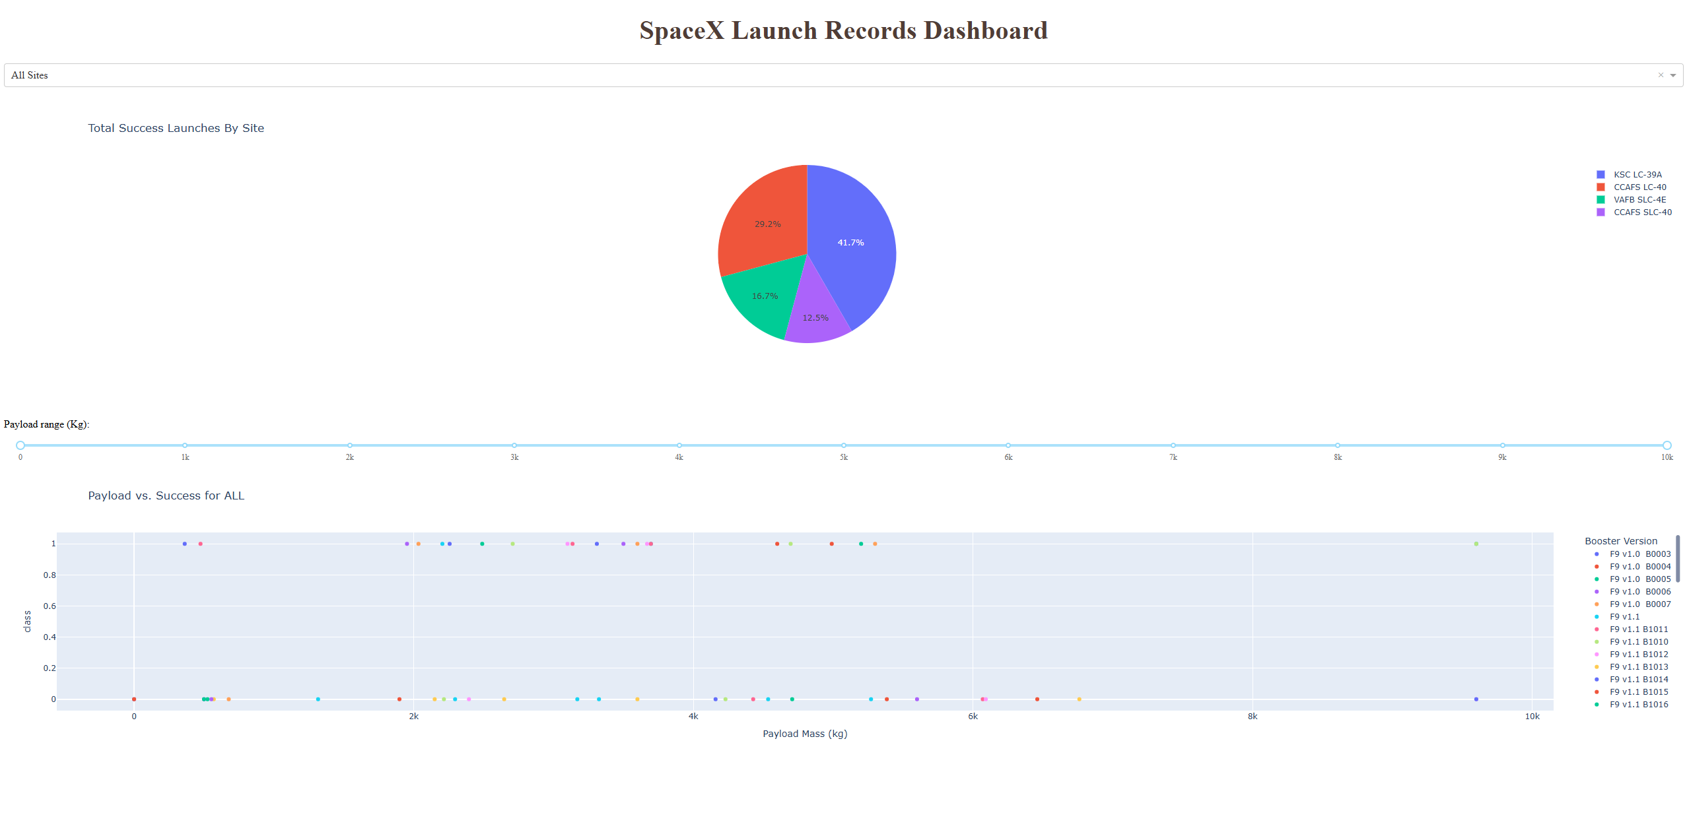
Results
Exploratory data analysis results
EDA showed that successful landings increased over time, especially for later flight numbers with higher payloads. Launch sites like KSC LC-39A and CCAFS SLC-40 had higher success rates than VAFB SLC 4E.
Missions to orbits like GEO and ES-L1 achieved consistently high success, while GTO and LEO had more variability. Successful landings were typically associated with mid-to-high payload ranges. A time trend revealed a sharp rise in success post-2014, reflecting improvements in rocket reuse and reliability.

Slide 17
Results
Predictive analysis results
We trained and evaluated four classification models—Logistic Regression, SVM, Decision Tree, and KNN—to predict Falcon 9 first-stage landing success. Logistic Regression, Decision Tree, and KNN each achieved the highest accuracy of 94.4%, while SVM followed closely with 88.9%.
Confusion matrices showed strong performance across models, with minimal false predictions. Logistic Regression, Decision Tree, and KNN correctly predicted all landing outcomes except for one false positive, making them the best performers in terms of both accuracy and reliability.

Slide 18

Section 2

Slide 19
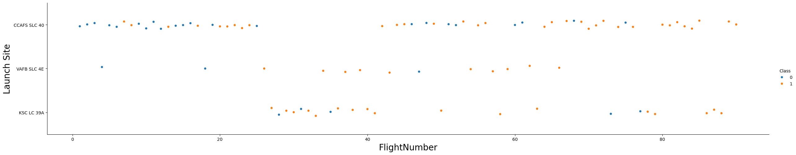
Flight Number vs. Launch Site
This scatter plot shows the distribution of Falcon 9 launches across different launch sites over time (represented by flight number), with colors indicating landing success (1) or failure (0).
The plot reveals that CCAFS SLC 40 and KSC LC 39A have had the most frequent launches and a higher proportion of successful landings in recent flights.
In contrast, VAFB SLC 4E has fewer launches and more variability in outcome. Overall, the trend suggests improved success rates over time, especially at high-traffic sites.

Slide 20
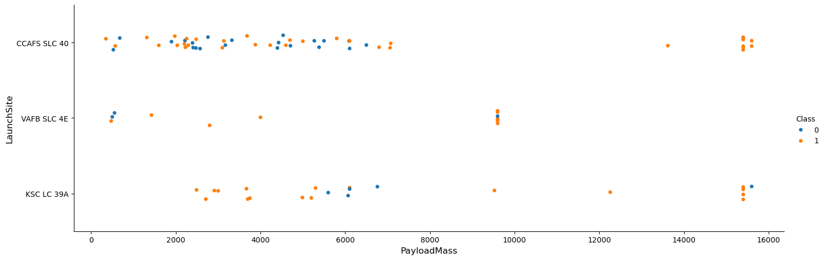
Payload vs. Launch Site
This scatter plot explores the relationship between launch sites, payload mass, and landing success. Each point represents a launch, colored by outcome (1 = success, 0 = failure).
The plot shows that CCAFS SLC 40 handled a wide range of payloads and achieved many successful landings, even at higher masses. KSC LC 39A also demonstrated strong performance with heavier payloads. In contrast, VAFB SLC 4E had fewer launches and more scattered outcomes.
Overall, higher payload missions were more common at major sites and still saw high success rates.

Slide 21
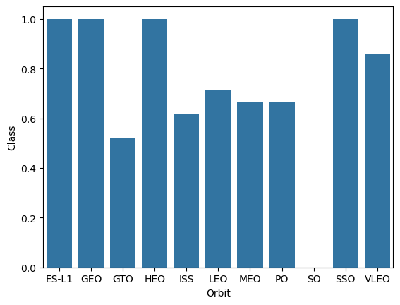
Success Rate vs. Orbit Type
This bar chart displays the average landing success rate across different orbit types. Missions targeting ES-L1, GEO, HEO, and SSO achieved a 100% success rate, indicating strong reliability for these orbits.
In contrast, missions to GTO had the lowest success rate, suggesting higher technical challenges or risk. Other orbits like LEO, MEO, and VLEO showed moderate but consistent performance.
These insights help identify which mission profiles are more favorable for achieving successful landings.

Slide 22
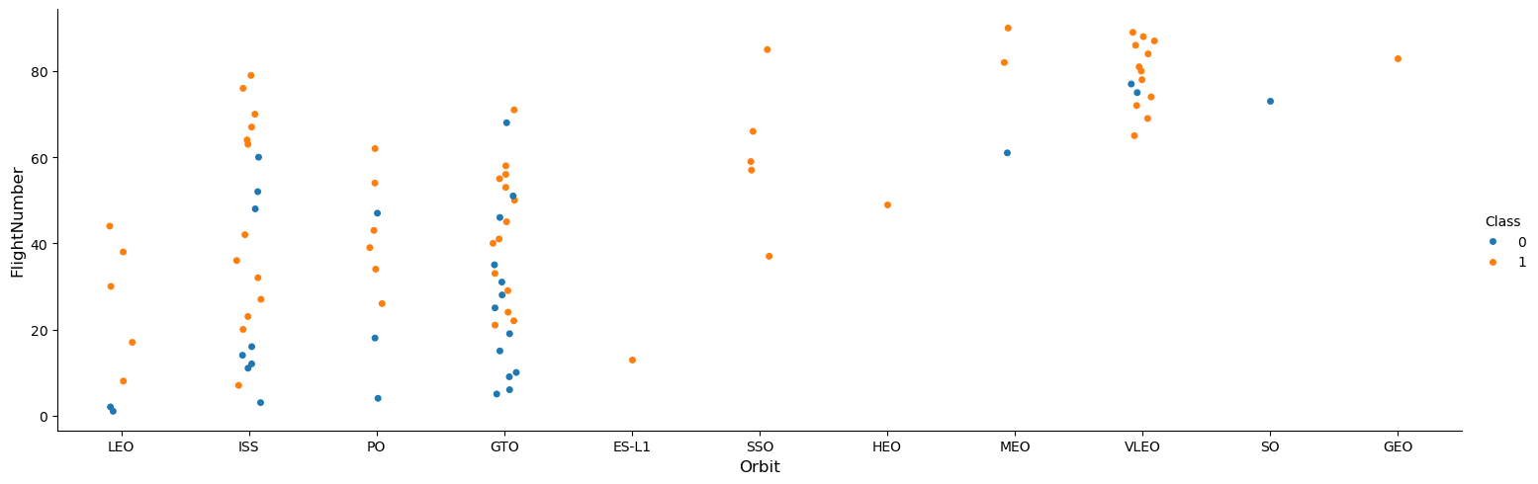
Flight Number vs. Orbit Type
This scatter plot illustrates the distribution of missions across orbit types over increasing flight numbers, with color indicating landing success.
It shows that more recent missions (higher flight numbers) to orbits like ISS, GTO, VLEO, and SSO have seen more consistent success (orange). In contrast, earlier missions and some targeting GTO or LEO had a higher rate of failures (blue).
The trend suggests that operational improvements over time have led to better success rates, especially for high-frequency orbit.

Slide 23
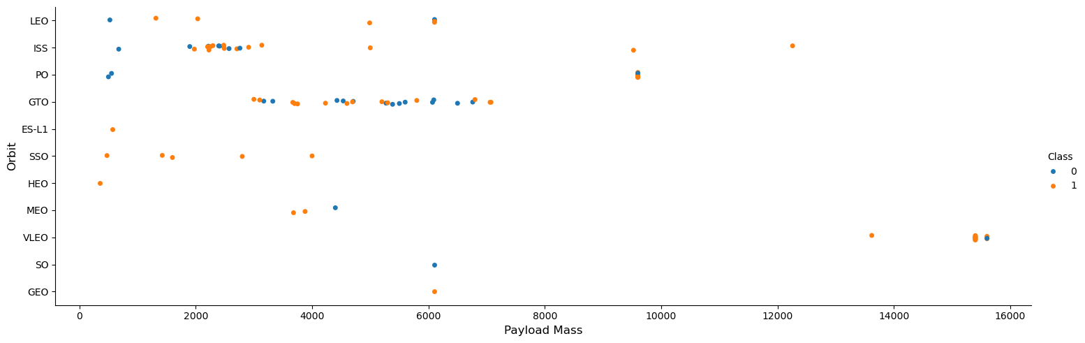
Payload vs. Orbit Type
This scatter plot shows the relationship between payload mass, orbit type, and landing success. Each dot represents a launch, color-coded by success (1 = orange, 0 = blue).
The chart reveals that GTO, ISS, and LEO missions span a wide payload range with mixed outcomes, while orbits like SSO, HEO, and VLEO generally see high success rates regardless of payload.
Notably, heavier payloads (≥10,000 kg) are mostly associated with successful landings, highlighting the capability of Falcon 9 to reliably deliver larger payloads to specific orbits.

Slide 24
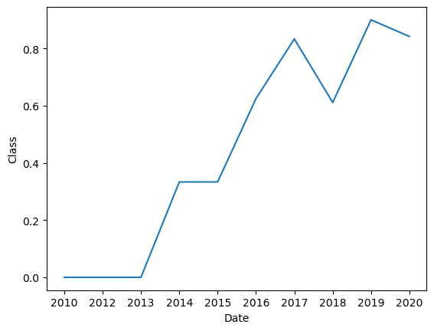
Launch Success Yearly Trend
The line chart illustrates a clear upward trend in Falcon 9 landing success rates over time.
From 2010 to 2013, success was minimal, but starting in 2014, there was a steady improvement, reaching over 90% success by 2019.
This trend reflects technological advancements and operational refinements in SpaceX’s reusable launch systems, highlighting their growing reliability and cost-efficiency year over year.

Slide 25
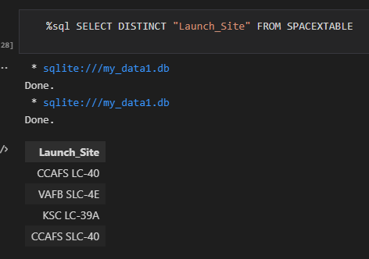
All Launch Site Names
Using an SQL query on the SpaceX dataset, we identified four distinct launch sites:
CCAFS LC-40
VAFB SLC-4E
KSC LC-39A
CCAFS SLC-40
These sites represent the geographical locations used for SpaceX launches, which are crucial for analyzing launch outcomes, regional performance, and site-specific trends in mission success.

Slide 26
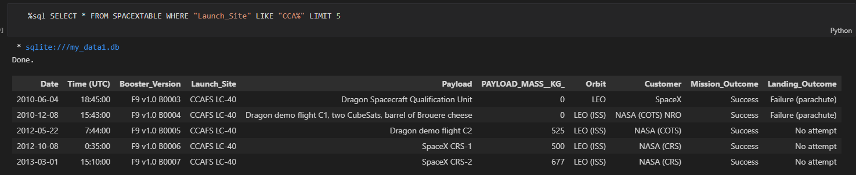
Launch Site Names Begin with 'CCA'
A filtered SQL query retrieved the first 5 launches from sites beginning with CCA, specifically CCAFS LC-40. All five missions were successful, showcasing early operational reliability. However, landing outcomes varied — two had parachute failures and the rest recorded no landing attempts. Payloads were primarily for NASA (COTS/CRS) missions, mostly to LEO (ISS) orbits, indicating SpaceX’s early focus on cargo delivery for government contracts.

Slide 27
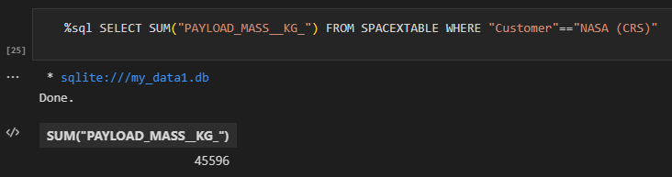
Total Payload Mass
An SQL SUM on the PAYLOAD_MASS__KG_ for all records where Customer = 'NASA (CRS)' returns 45,596 kg.
This figure represents the cumulative mass of cargo that SpaceX has delivered under NASA contracts.

Slide 28
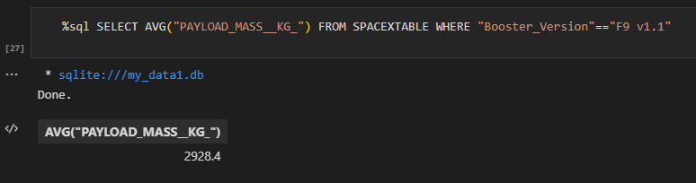
Average Payload Mass by F9 v1.1
An SQL AVG query on the PAYLOAD_MASS__KG_ for records where Booster_Version = 'F9 v1.1' yields 2,928.4 kg.
This value represents the typical payload capacity carried by the F9 v1.1 boosters and serves as a benchmark for comparing performance across different booster versions.

Slide 29
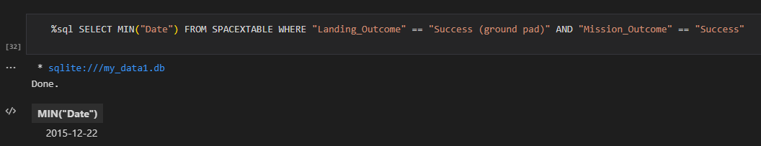
First Successful Ground Landing Date
An SQL MIN(Date) query filtered for records where both Mission_Outcome = 'Success' and Landing_Outcome = 'Success (ground pad)' returns 2015‑12‑22.
This date marks SpaceX’s first successful return and landing of the Falcon 9 first stage on a ground pad.

Slide 30
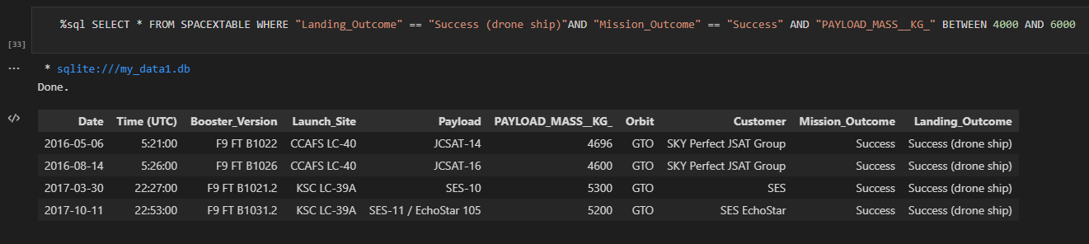
Successful Drone Ship Landing with Payload between 4000 and 6000
Four boosters—F9 FT B1022, B1026, B1021.2, and B1031.2—achieved successful drone ship landings while carrying payloads between 4000 and 6000 kg.
This demonstrates SpaceX’s capability to land boosters reliably under moderate payload stress during GTO missions.

Slide 31
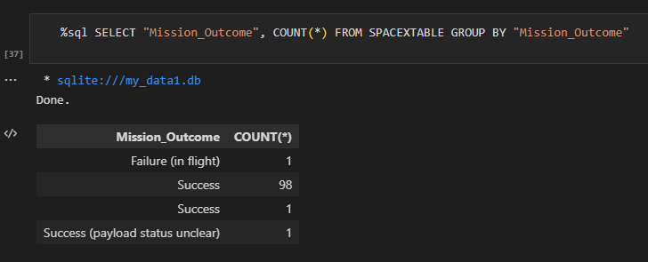
Total Number of Successful and Failure Mission Outcomes
We analyzed the mission outcomes of SpaceX launches. The data shows that:
98 missions were successful
1 mission failed in flight
2 additional entries were labeled as “Success” and “Success (payload status unclear)”
This indicates an overwhelming success rate, highlighting the operational reliability of SpaceX launch missions, with only one recorded in-flight failure.

Slide 32
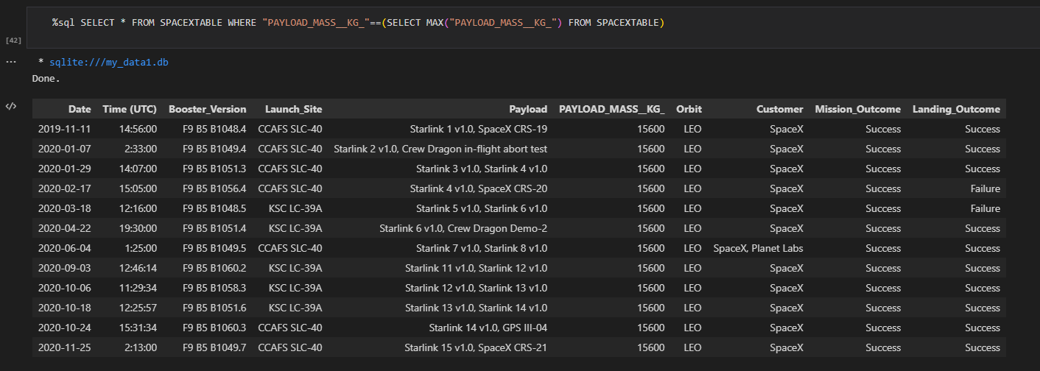
Boosters Carried Maximum Payload
All listed boosters carried the maximum payload of 15,600 kg. These missions were primarily Starlink launches and were conducted by F9 B5 boosters across various block versions (e.g., B1048.4, B1049.4, etc.). Most missions were successful in both delivery and landing.
The F9 B5 series consistently supports the heaviest payloads, showcasing its significance in SpaceX's heavy-lift operations.

Slide 33
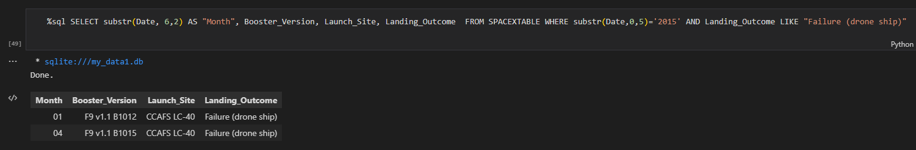
2015 Launch Records
In 2015, two missions experienced drone ship landing failures. Both launches occurred at CCAFS LC-40, using booster versions:
F9 v1.1 B1012 (January)
F9 v1.1 B1015 (April)
This insight highlights early-stage recovery challenges SpaceX faced with drone ship landings during that year.

Slide 34
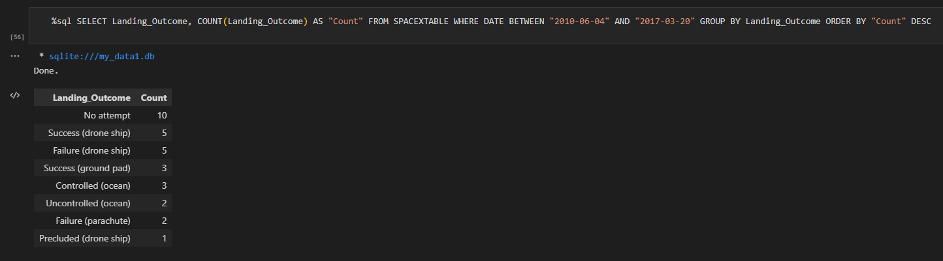
Rank Landing Outcomes Between 2010-06-04 and 2017-03-20
The most common result was “No attempt” (10 times), indicating early missions lacked recovery attempts.
“Success (drone ship)” and “Failure (drone ship)” were tied with 5 occurrences each, showing the evolving but still maturing recovery efforts on sea platforms.
Other outcomes included ground pad successes (3), controlled/uncontrolled ocean landings, and parachute failures, each occurring 1–3 times.
Recovery reliability improved over time, but in this period, drone ship landings had mixed outcomes, and recovery was not attempted in several early missions.

Slide 35

Section 3

Slide 36
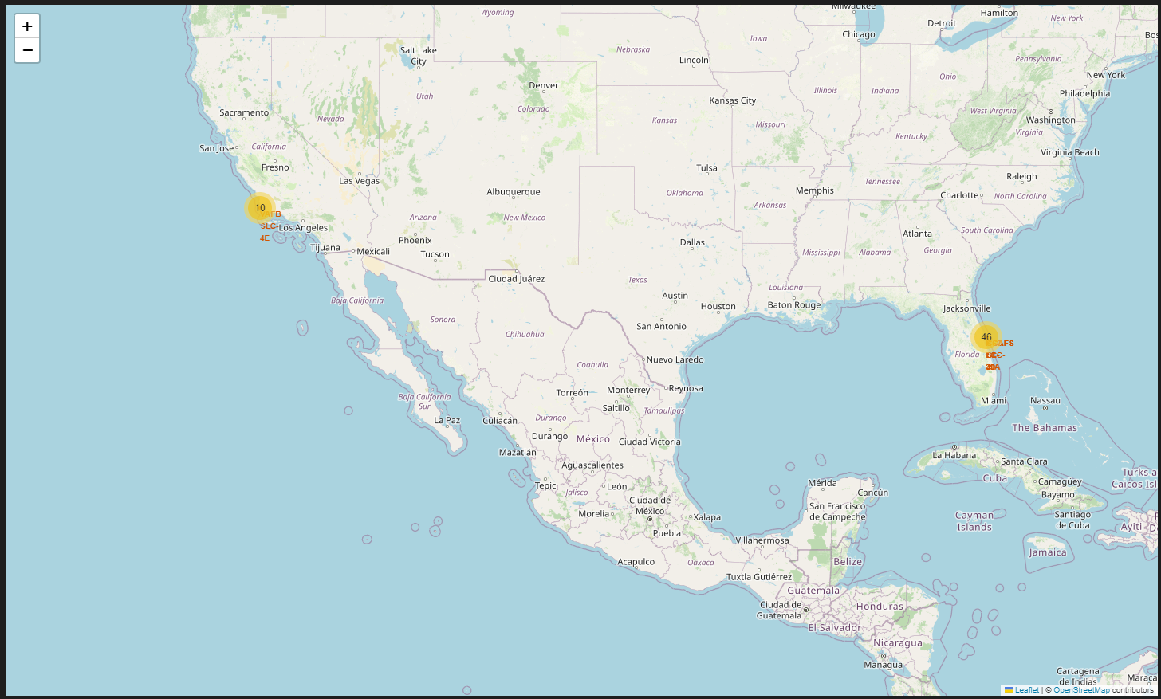
Launch Site Distribution Overview
The folium map displays the geographical distribution of SpaceX launch sites across the U.S. Each marker on the map represents a launch site, clustered to show density and labeled for identification.
High concentration of launches from Florida (marked with “46”), specifically around the Cape Canaveral and Kennedy Space Center areas.
Secondary cluster in California (marked with “10”), likely representing Vandenberg Air Force Base.
Marker clustering helps distinguish frequently used sites from less active ones.

Slide 37
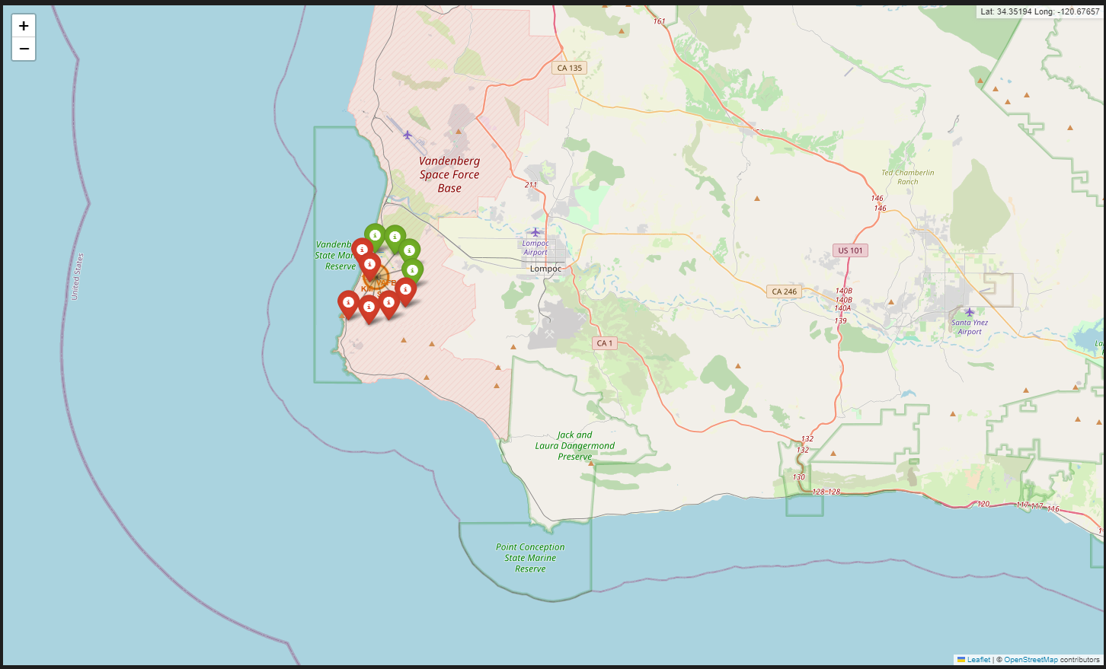
Launch Outcomes at Vandenberg Space Force Base (VAFB)
The map highlights the launch activities concentrated around VAFB in California.
Green markers represent successful landings, while red markers indicate failures.

Slide 38
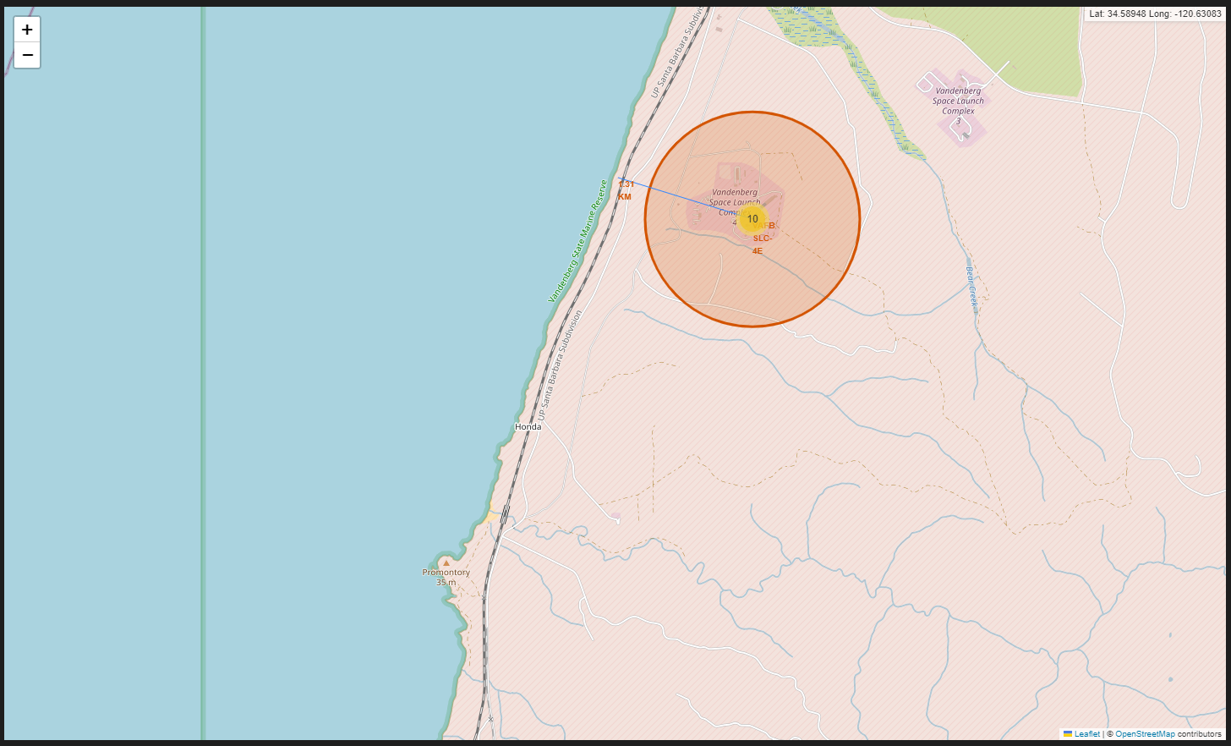
Launch Site and Nearby Coastline Proximity
The Vandenberg launch site is strategically located near the coast (~1.3 km), which is beneficial for over-ocean launches (minimizing risk to populated areas).
The map demonstrates the site's accessibility and suitability for orbital launches toward the Pacific.
This proximity analysis helps in assessing safety zones, potential recovery areas, and environmental considerations.

Slide 39

Section 4

Slide 40
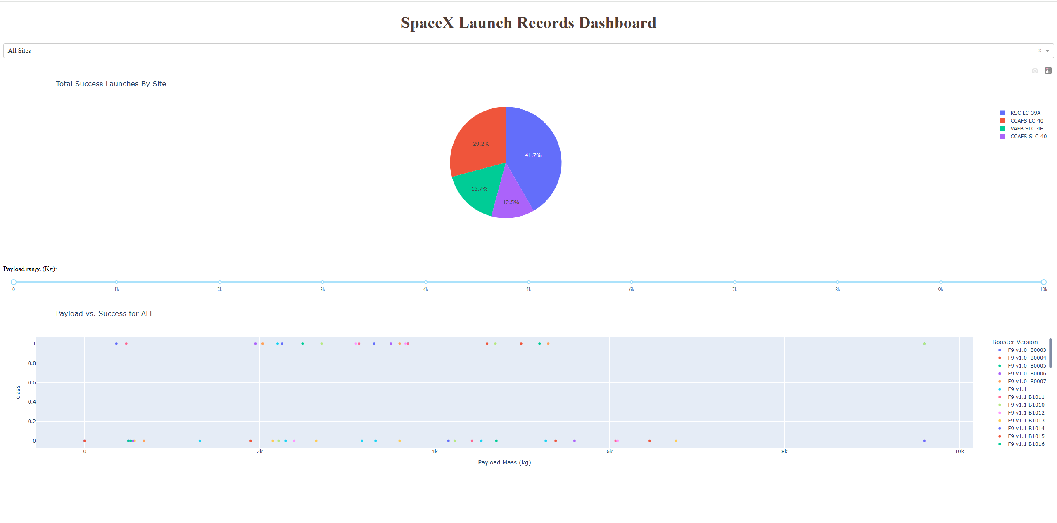
Plotly Dashboard
Interactive Plotly Dashboard provides dynamic filtering of launch success data by site and payload range, enhancing exploratory data analysis.
Combines pie chart and scatter plot views to visually correlate launch site performance and payload success patterns, making trends easier to interpret.
KSC LC-39A accounts for the highest share (41.7%) of successful launches, followed by CCAFS LC-40 (29.2%), indicating strong performance at these sites.
Scatter plot shows most payloads (0–10,000 kg) tend to succeed, with some failure variation across different booster versions.

Slide 41
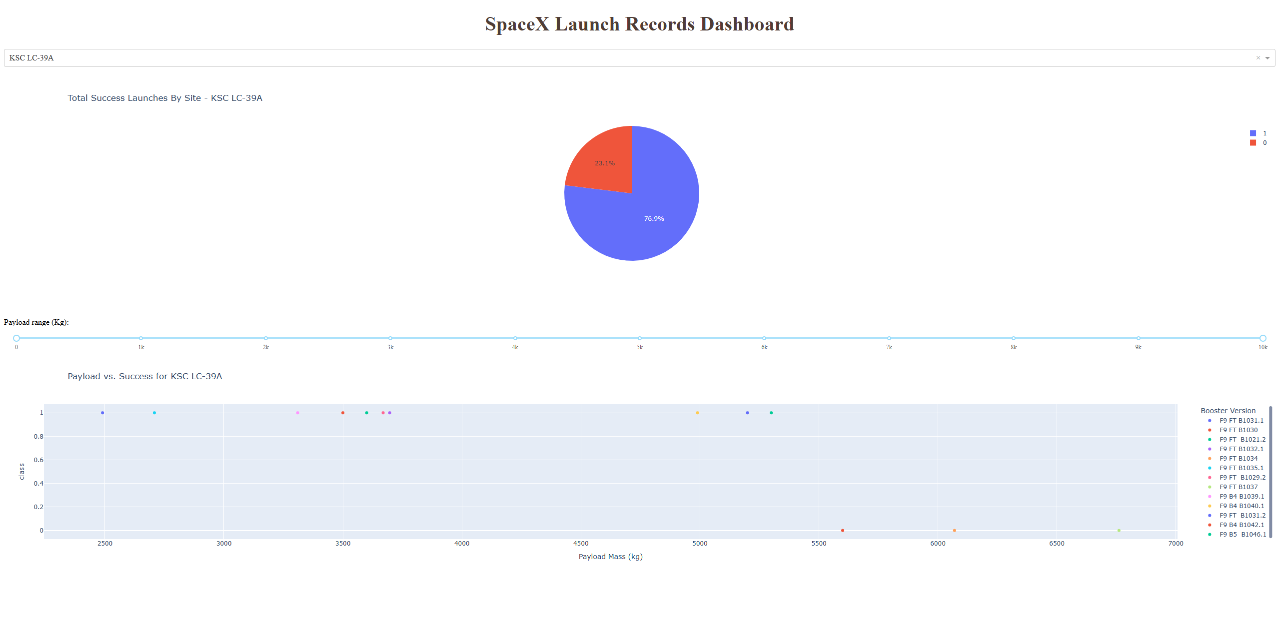
Dashboard: Launch Site with Highest Success Ratio (KSC LC-39A)
The interactive dashboard filters SpaceX data by launch site and payload range, providing instant insights via pie and scatter plots.
For KSC LC-39A, the pie chart shows a ~77% success rate, confirming it as the site with the highest launch success ratio.

Slide 42

Section 5

Slide 43
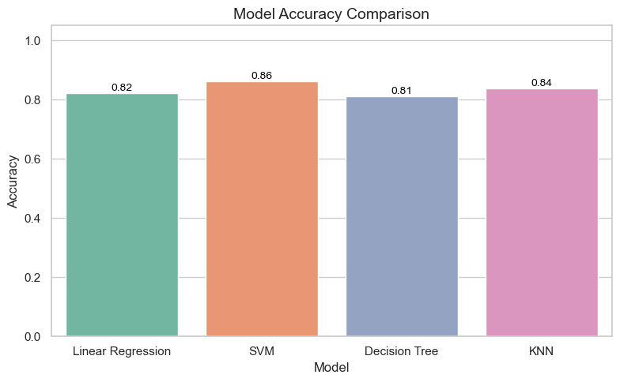
Classification Accuracy
A bar chart compares the accuracy of four classification models: Linear Regression, SVM, Decision Tree, and KNN.
Among them, SVM achieved the highest classification accuracy of 0.86, making it the most effective model for this dataset.

Slide 44
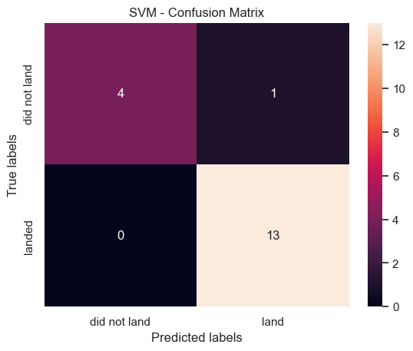
Confusion Matrix
The SVM model, which achieved the highest accuracy (0.86), shows strong classification performance with only one misclassified case.
The confusion matrix indicates 13 correct land predictions and 4 correct 'did not land' predictions, suggesting high precision and recall for both classes.

Slide 45
Conclusions
Data scraping and wrangling involved cleaning SpaceX launch records, extracting launch outcome details, and harmonizing payload data for effective analysis.
EDA revealed key insights such as booster version F9 v1.1 frequently carrying payloads above 4000 kg and NASA contributing significantly to total payload mass.
Launch outcome analysis showed increasing landing success over time, with most failures concentrated before 2015 and successes dominated by ground pad and drone ship recoveries.
Among all ML models, SVM achieved the highest classification accuracy (86%), making it the best performer for predicting launch success.
Folium maps visualized global launch site locations and their proximities to coastlines and infrastructure, aiding logistical insights.
The Plotly dashboard allowed interactive exploration of launch outcomes by site and payload, making trends and patterns easily understandable.

Slide 46

https://github.com/panderior/IBM-DS-Capstone-proj

